Slide 1

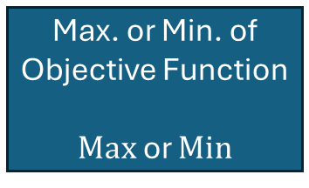
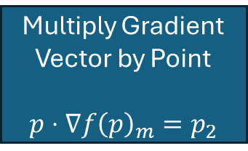
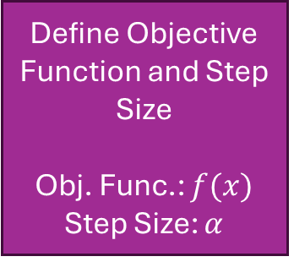
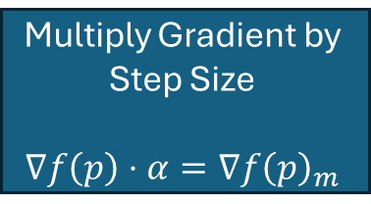
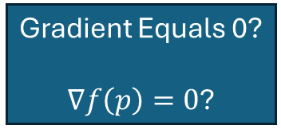
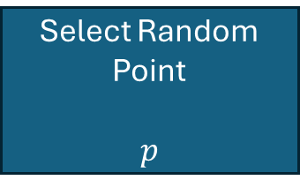
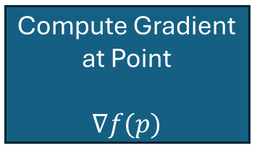
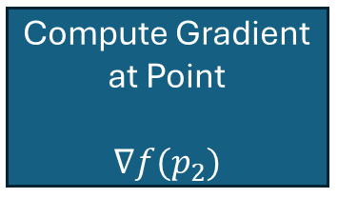
Define Objective Function and Step Size
Obj. Func.: $f(x)$
Step Size: $α$
Max. or Min. of Objective Function
$Max$ or $Min$
Select Random Point
$$p$$
End
Compute Gradient at Point
$$∇f(p)$$
Optimal Point Reached
True
Start
Gradient Equals 0?
$∇f\left(p\right)=0$?
Multiply Gradient by Step Size
$$∇f\left(p\right)⋅α=∇f{\left(p\right)}_{m}$$
False
Multiply Gradient Vector by Point
$$p⋅∇f{\left(p\right)}_{m}=p_{2}$$
Get New Point
$$p_{2}$$
Compute Gradient at Point
$${∇f(p}_{2})$$

